Slide 1

Resume Builder
(A Web Application)

Slide 2
Team-01
Ravi Krishna Teja Dachepalli
Jayanth Golla
Manoj Desetty
Anudeep Tippireddy

Slide 3
Background Story
Individuals finding it difficult to create a Resume from scratch , in any job application process or in any other business. It must be kept short, straightforward, and current with work experience, and it must be updated on a regular basis.
One of my friends found it hard to build and modify a resume every single time while applying for different on campus jobs. So , this made us think about an online web application that will automatically generate a good format resume from the input entered by the user.

Slide 4
Data
Here the data is Users Input. Users input is taken as raw data and this data will be formatted to give a resume.
This project doesn’t need any sampling as the user gives only the requested data.
This data will be fresh for every user and this application will not be working with any global or previous data.
This data doesn’t contain geographical information or any other factors like regional, national or global as the data is user specific.

Slide 5
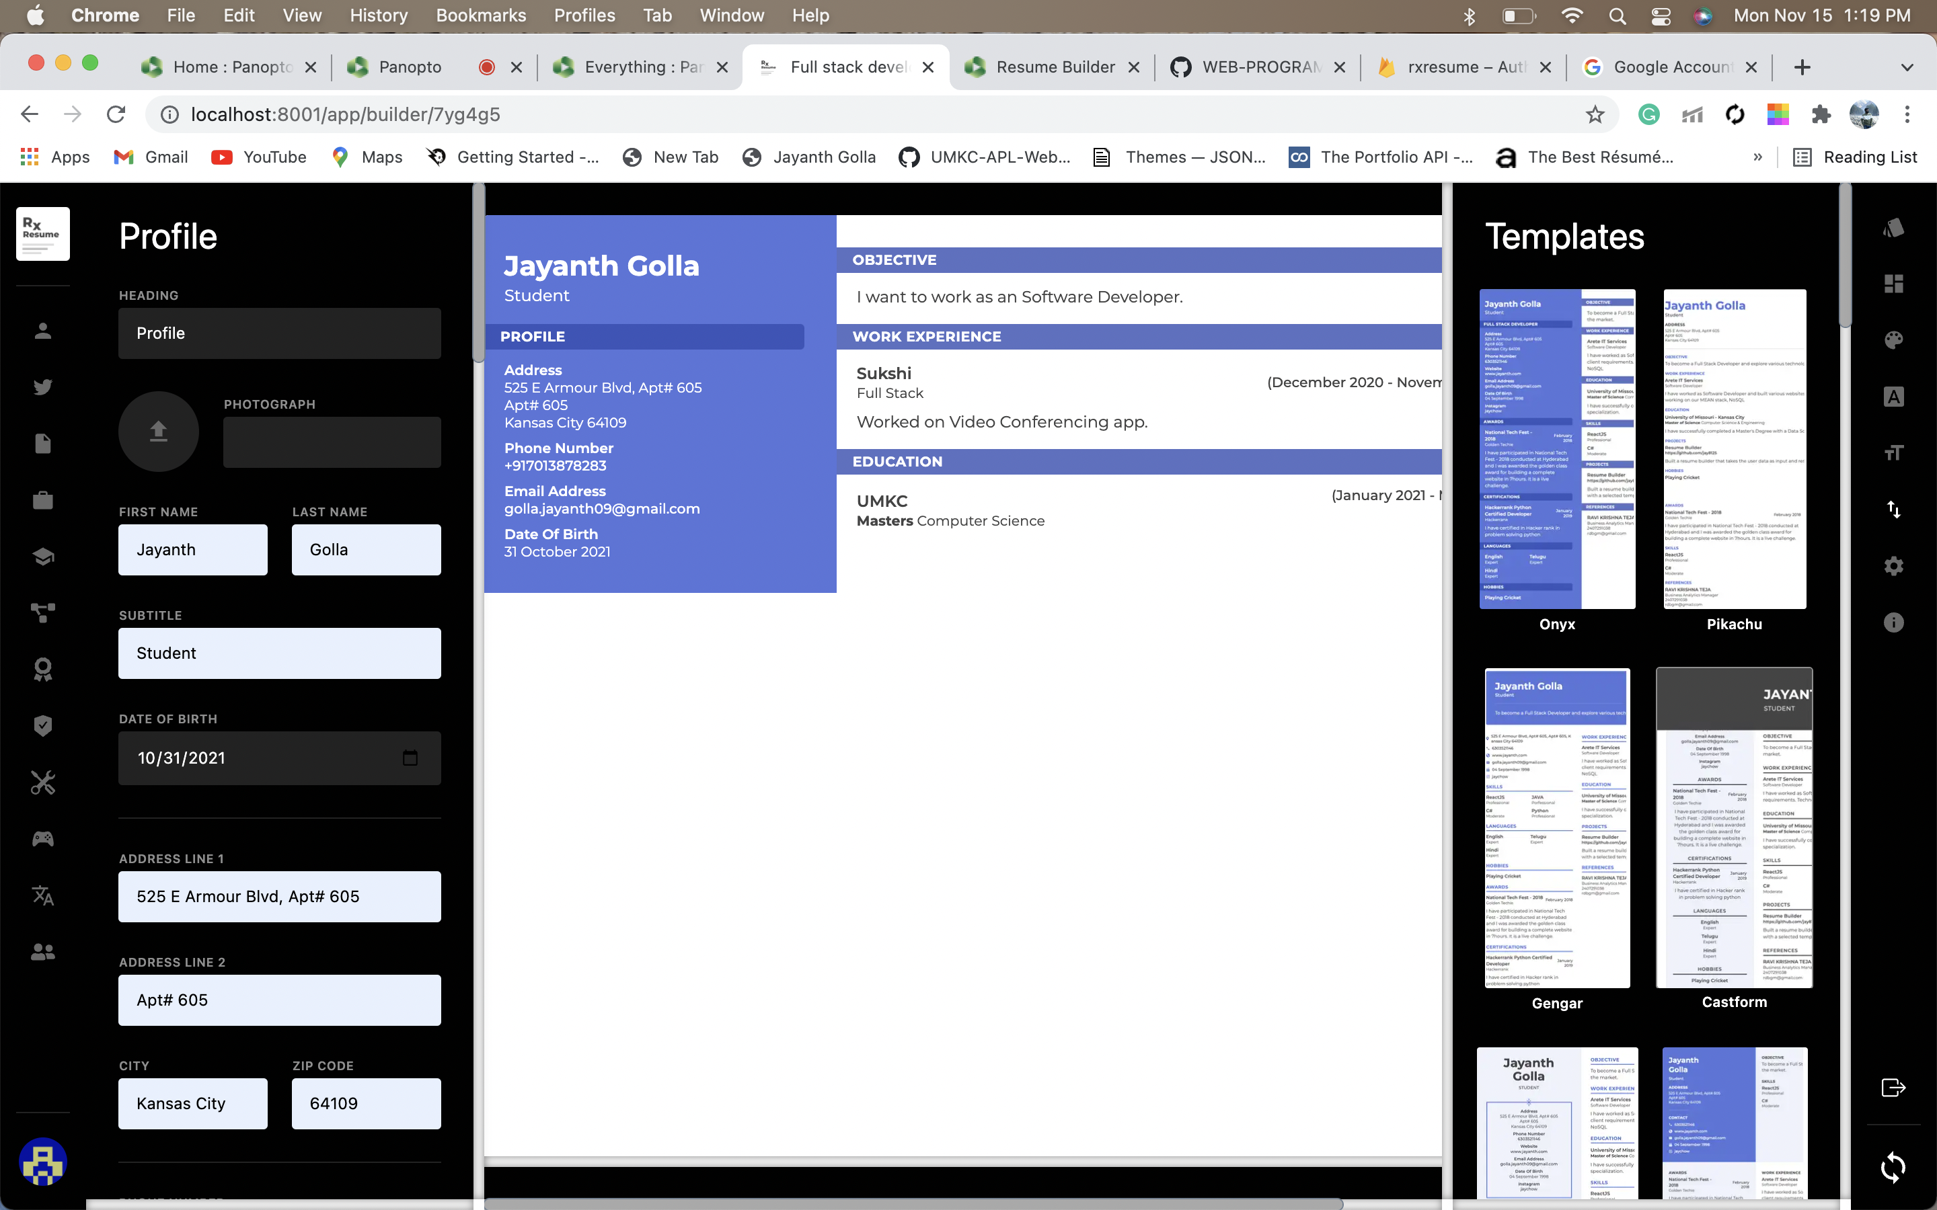
Main Page
Main screen, where user can fill out the details for our resume.
This data will be used to build resume in different templates according to the user selection.

Slide 6
Features
User Authentication
User can create an account or sign in through Gmail or sign in anonymously

Slide 7
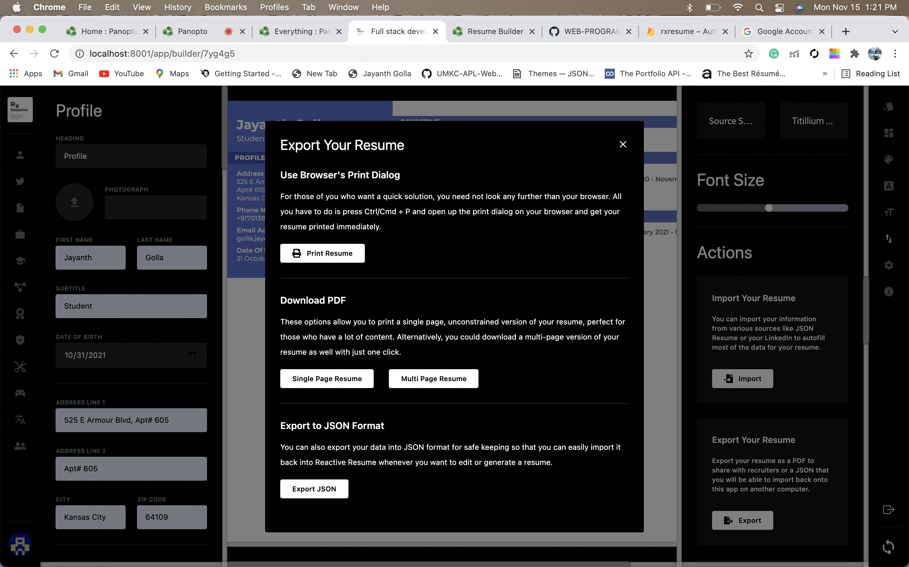
Features
Another important feature is that user can import, export, print and download resume.
This enables user friendly experience.

Slide 8
Features
User can select any template out of the 6 provided templates.
User can change the color of the template.
User can access font, font size, layout colors etc. in the side bar provided.

Slide 9
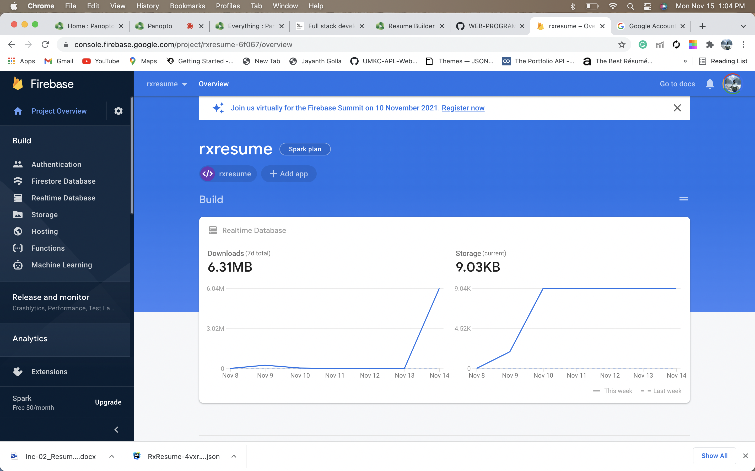
Database
Firebase Realtime Database is used to store the data and database schema is created according to the requirement.

Slide 10
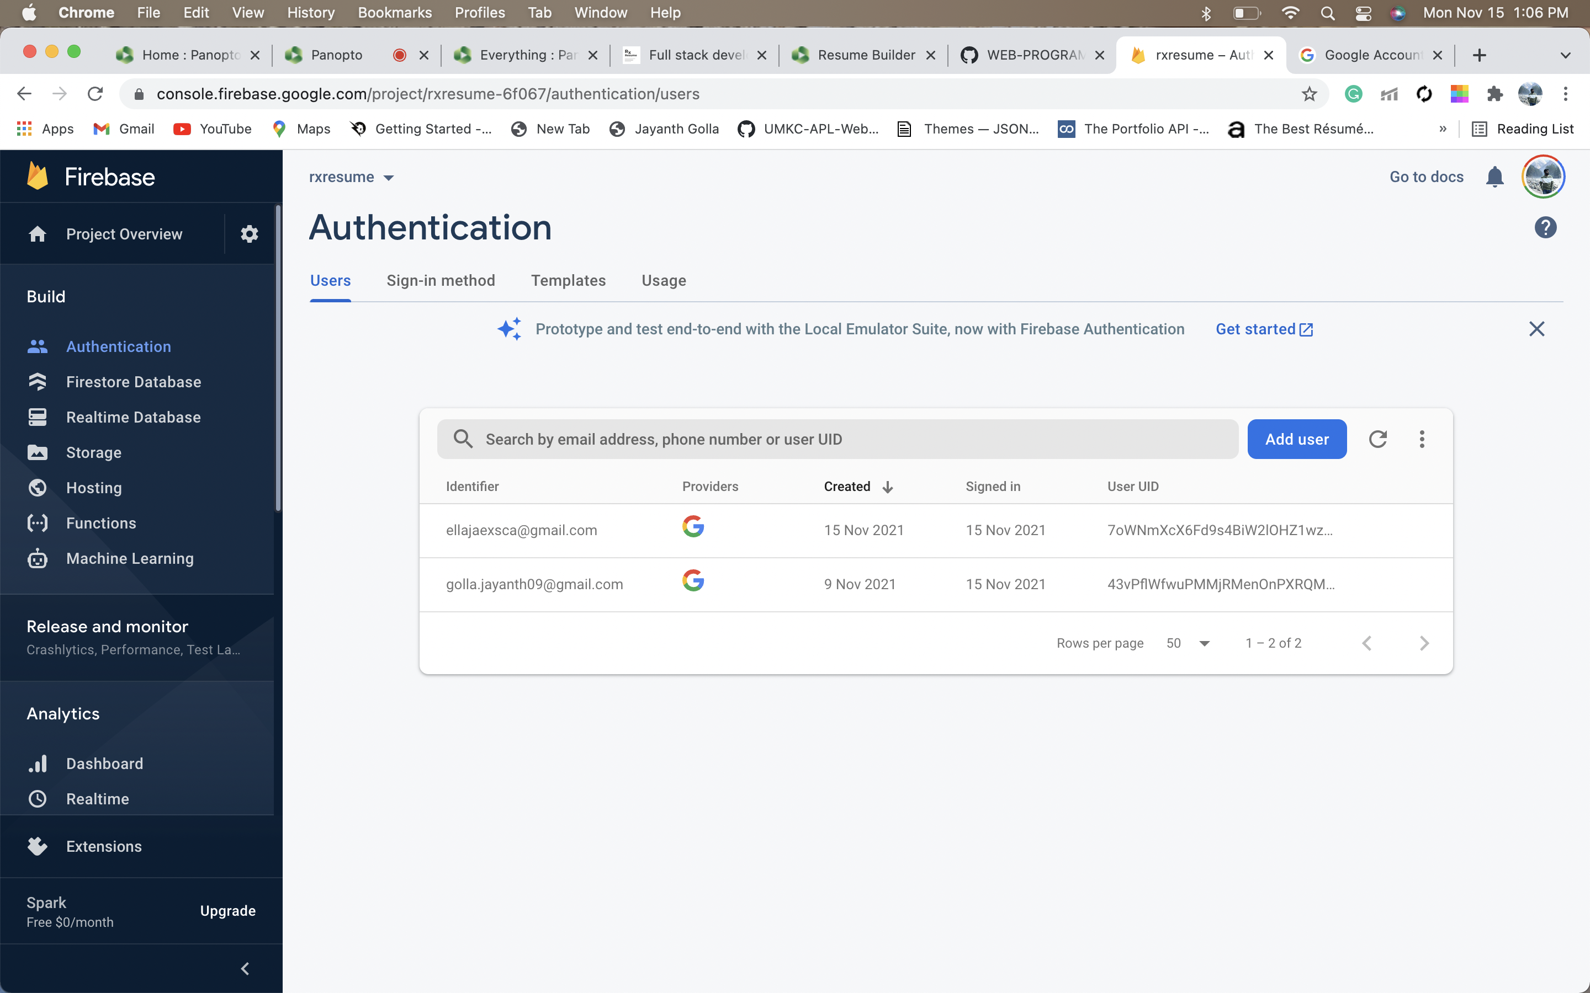
Database
For Authentication, you can login through Gmail or Anonymously.
The picture displays the list of users in the database.

Slide 11
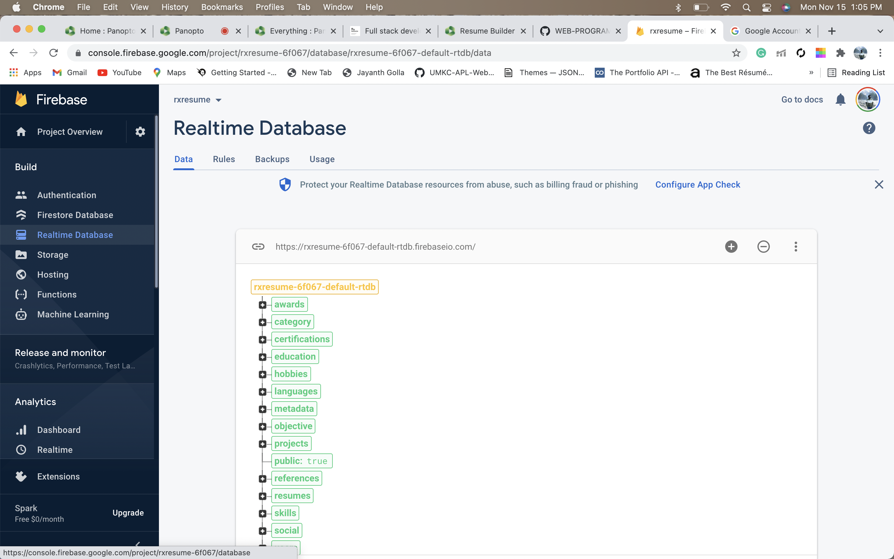
Database
This picture displays the space to write schema for the database.

Slide 12
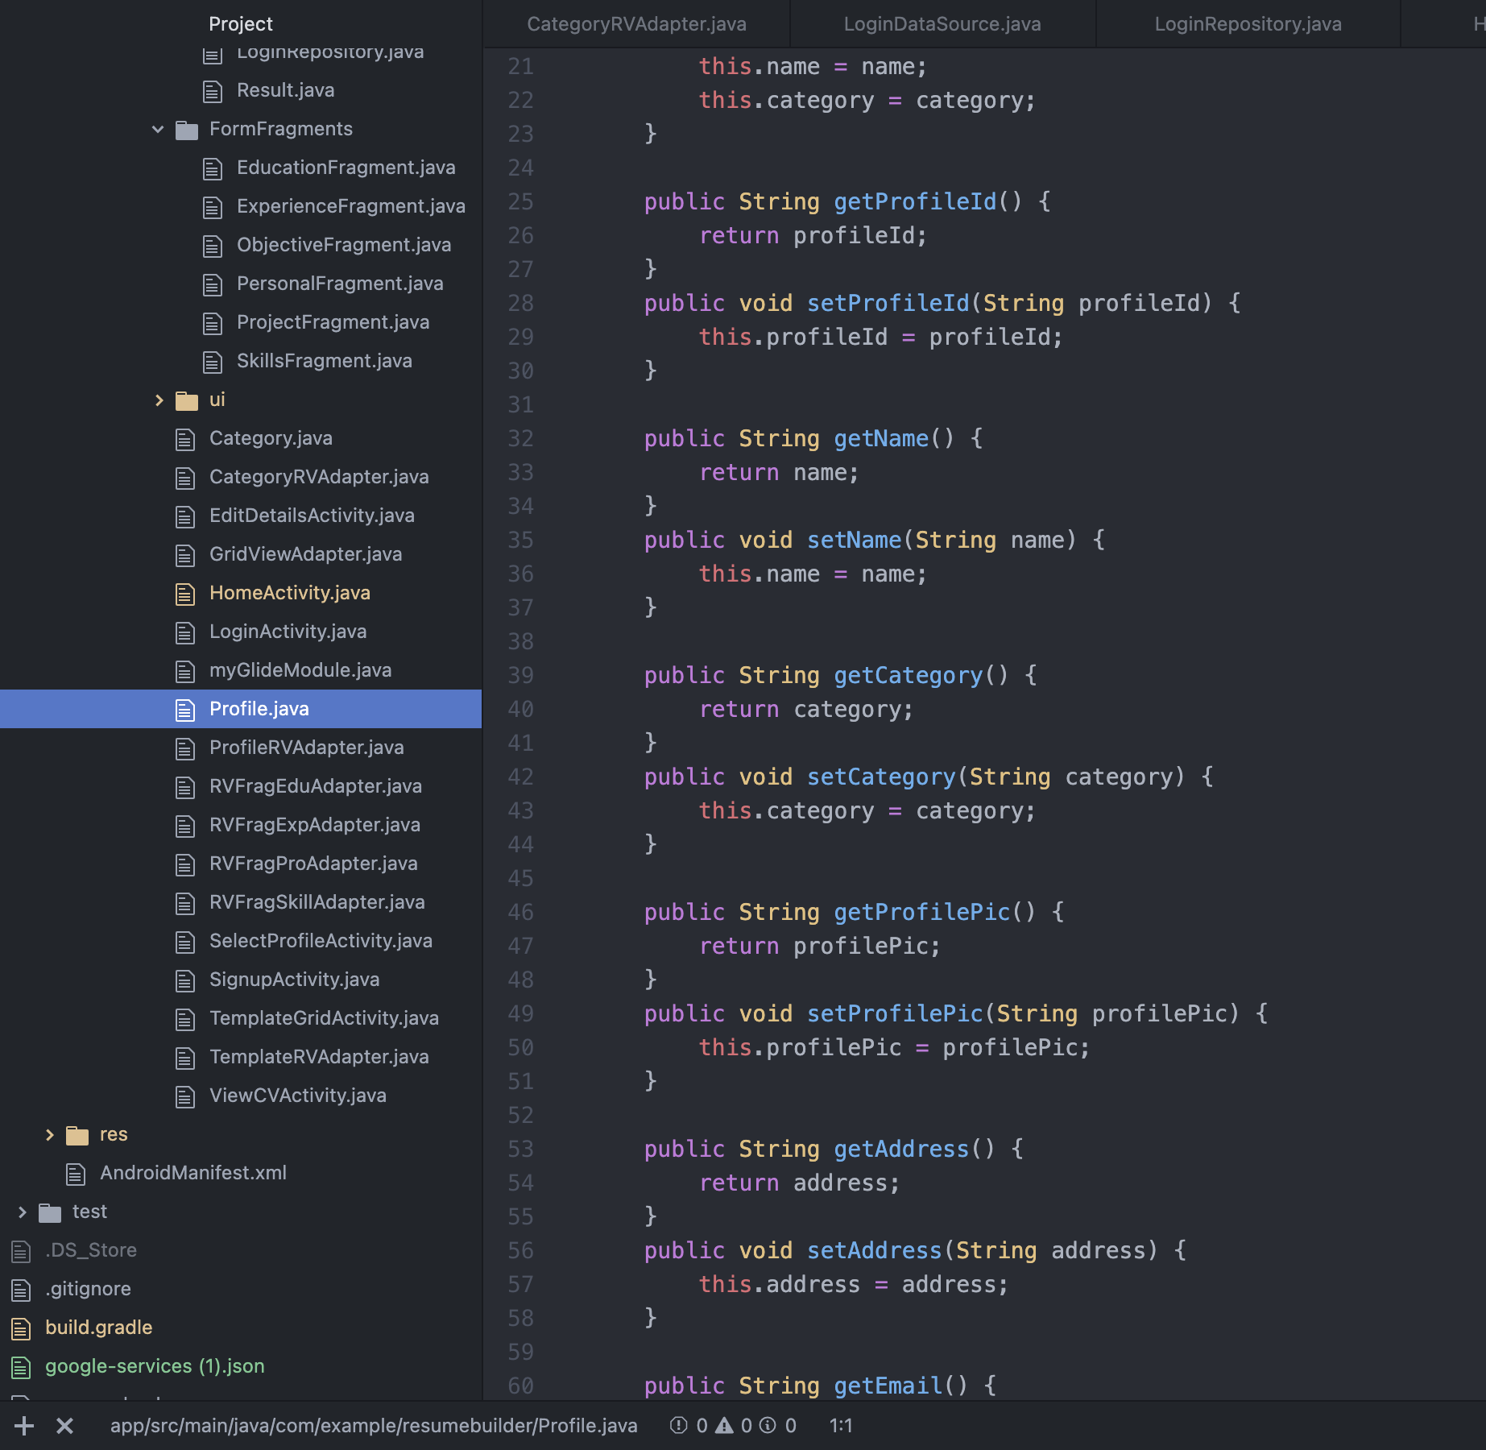
Code for profile information
Code Snippets

Slide 13
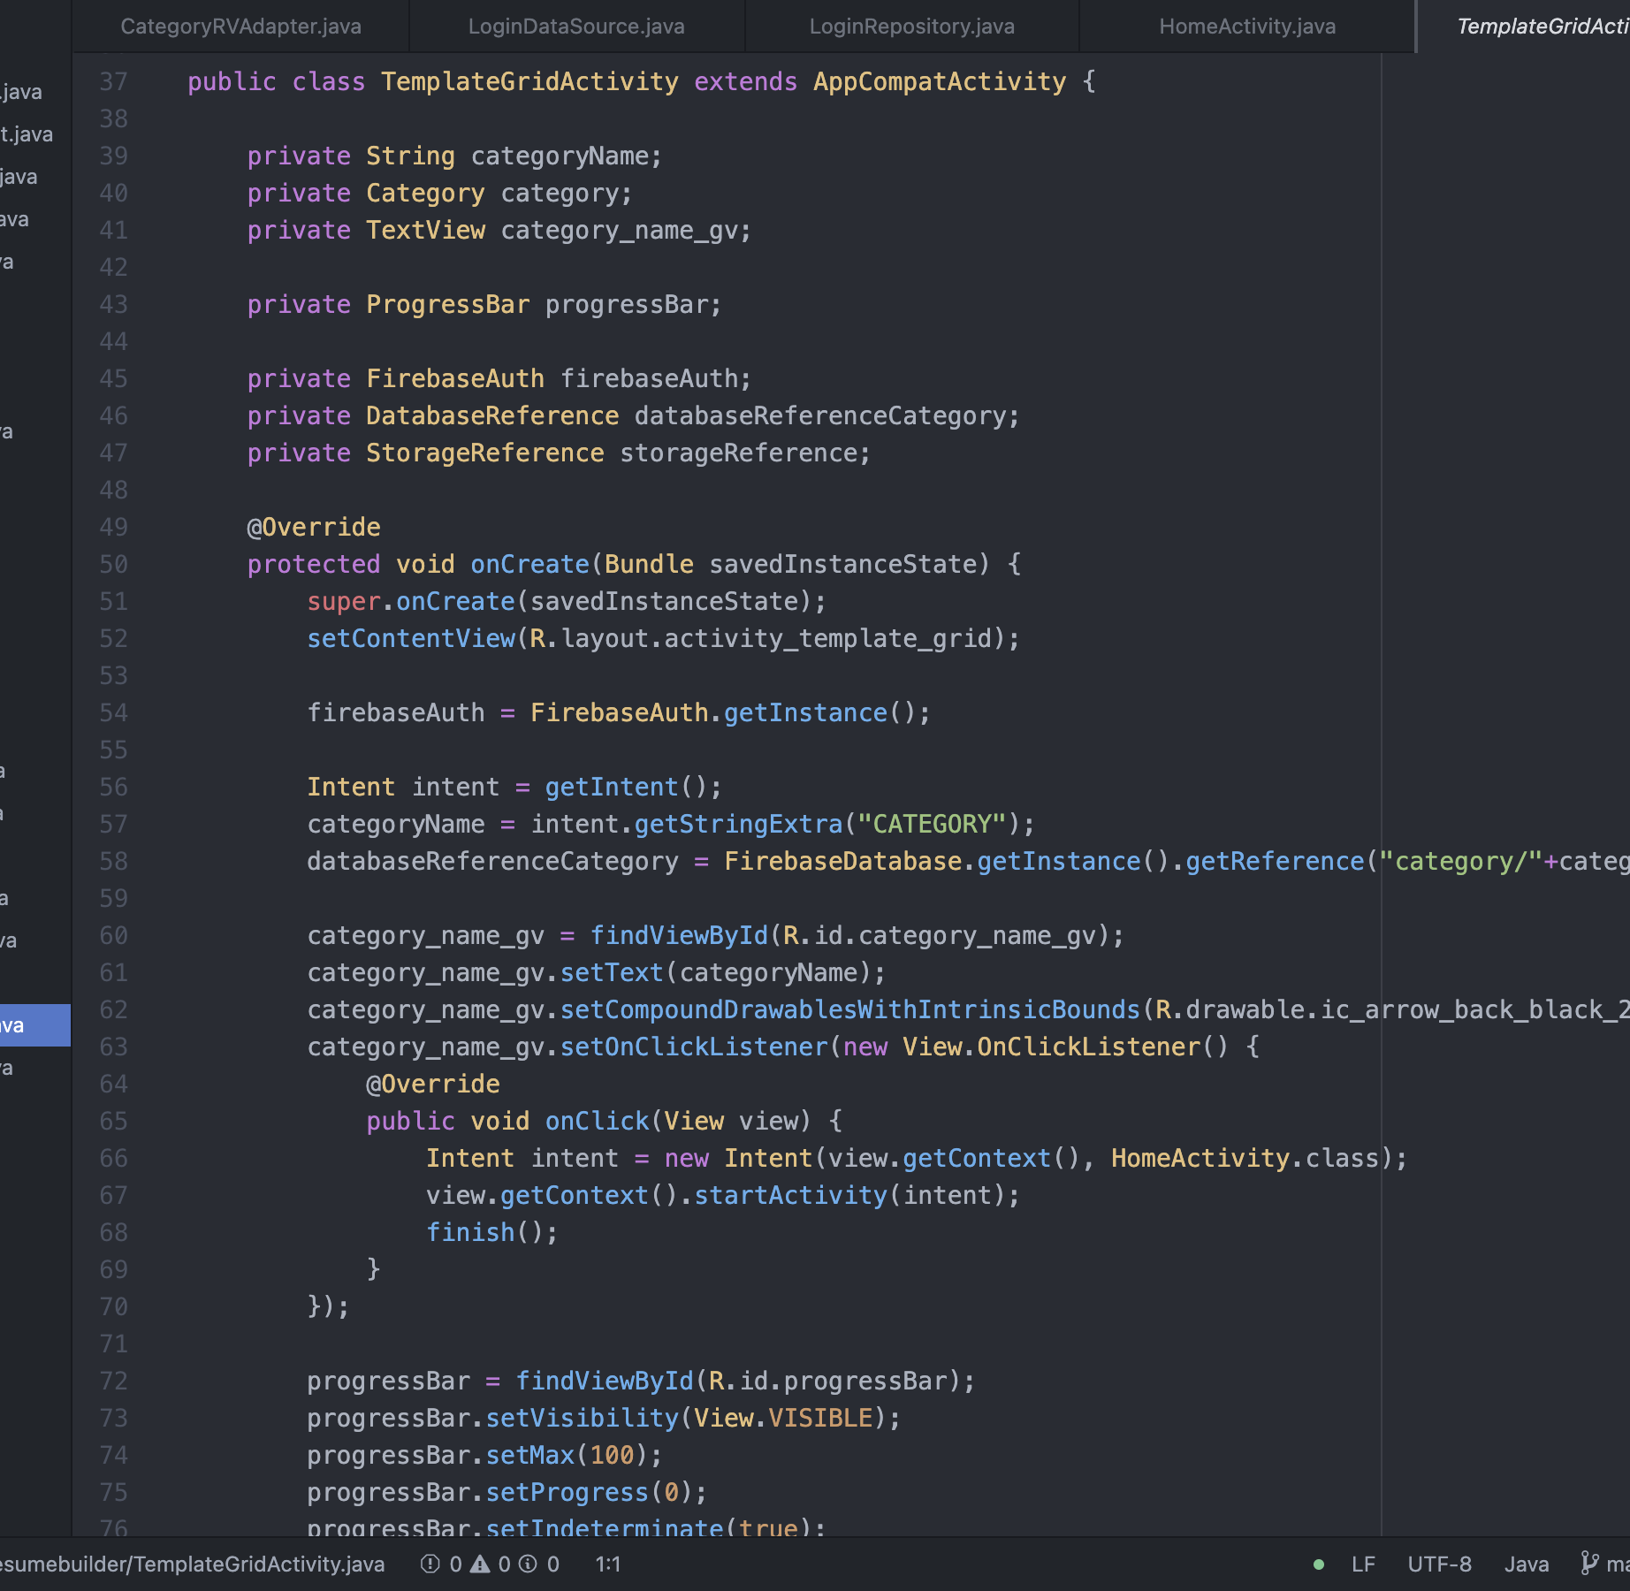
Code for templates
Code Snippets

Slide 14
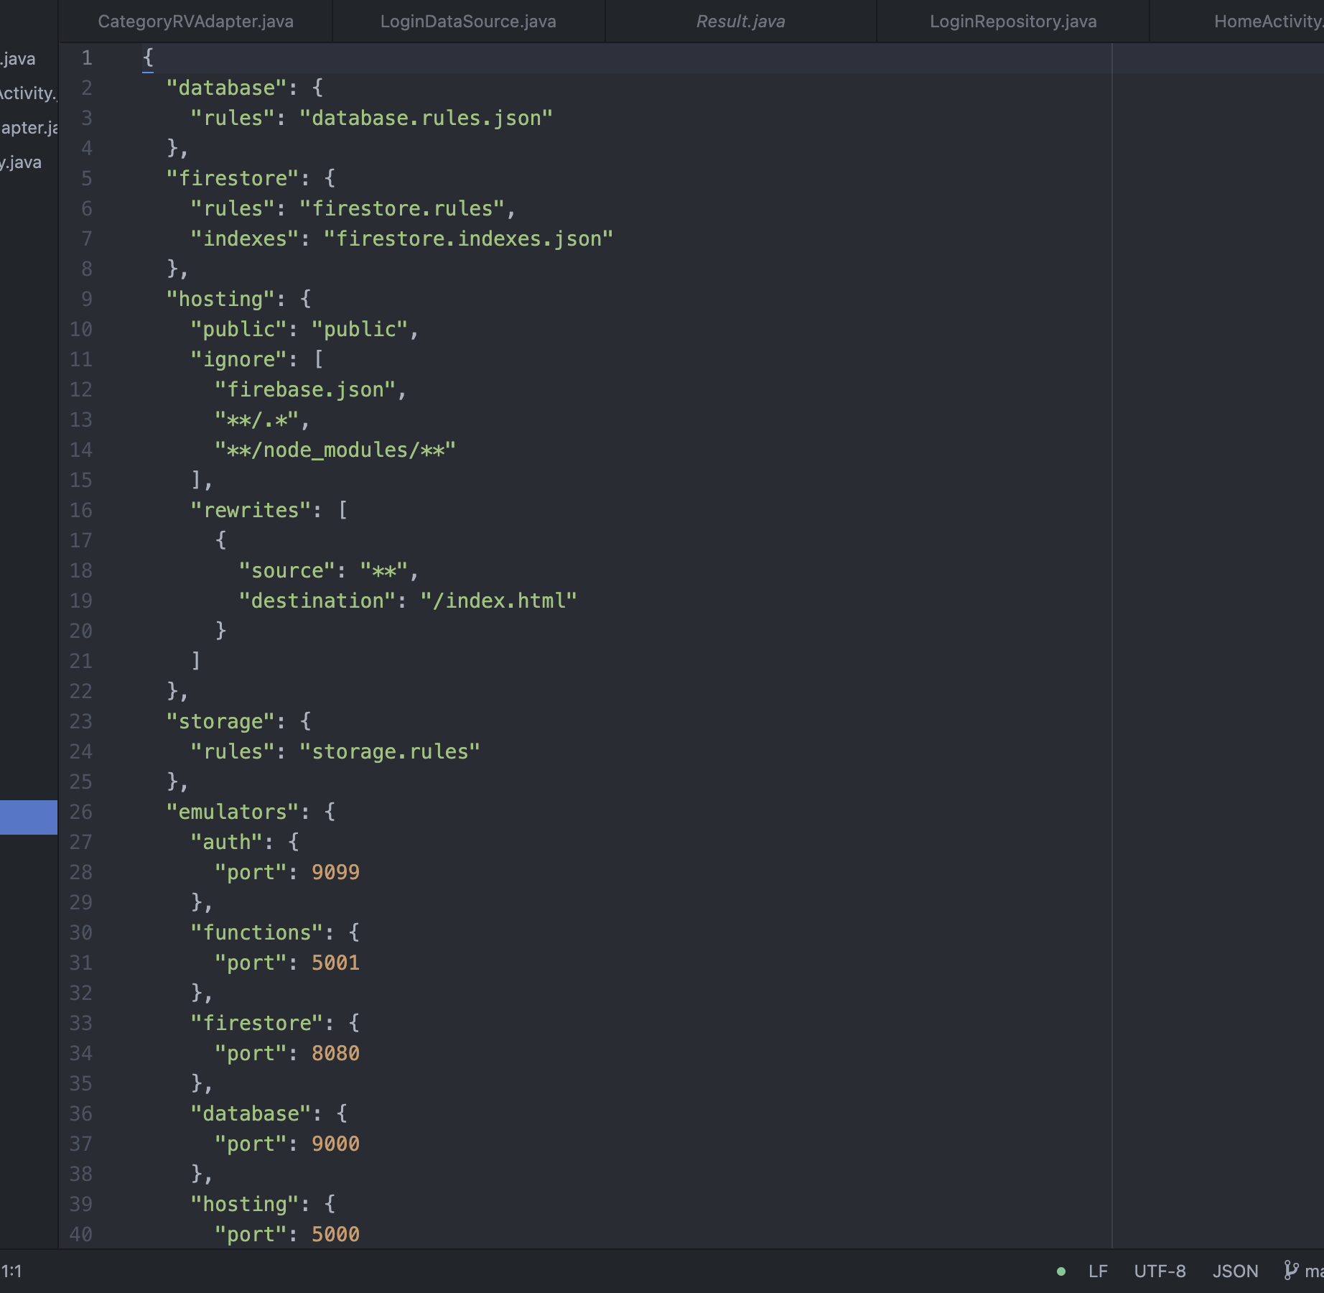
Code for firebase
Code Snippets

Slide 15
Issues:
Establishing proper connection with Firebase Realtime Database
Creating appropriate schema in the database
Issues with cascading style sheets while designing the website.

Slide 16
Work Distribution
Front end :
Anudeep & Jayanth
Back end :
Jayanth, Manoj, Anudeep & Ravi
Documentation :
Ravi & Manoj

Slide 17
References
Wikipedia: https://en.wikipedia.org/
Smallpdf: https://smallpdf.com/
Resume Genius: https://resumegenius.com/
Firebase: https://firebase.google.com/docs
Article: http://www.prosperoverseas.com/sample-resume

Slide 18
Suggestions are appreciated….!!
Thank you

